Slide 1
DART Expansion Programme & DART Underground Project
September 2015

Slide 2
DART Expansion Programme
The DART Expansion Programme comprises a major enlargement of the existing DART system and will form a cornerstone of the Dublin region’s future transport system
DART Expansion Programme
  Rail tunnel linking the Kildare line west of Heuston Station to the Northern line east of Connolly Station (known as the DART Underground Project – see below)
  The extension of electrification to Drogheda, Maynooth, and Hazelhatch
  Completion of 4 tracking of Kildare line
  Expansion of fleet and depot facilities
  Dublin City Centre Re-signalling and new Centralised Traffic Control Centre
DART Underground Project
  The tunnel section of the programme with stations at Inchicore, Heuston, Christchurch, Saint Stephens Green, Pearse and Docklands

Slide 3
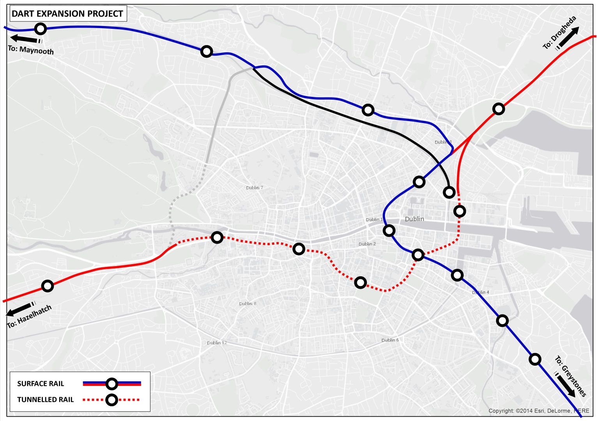
DART Expansion Programme
The DART Expansion Programme will provide a DART service from Drogheda to Hazelhatch via the city centre tunnel and a second segregated DART service operating from Maynooth to Greystones.
The two segregated services will intersect at Pearse station, which will be the main passenger interchange.

Slide 4
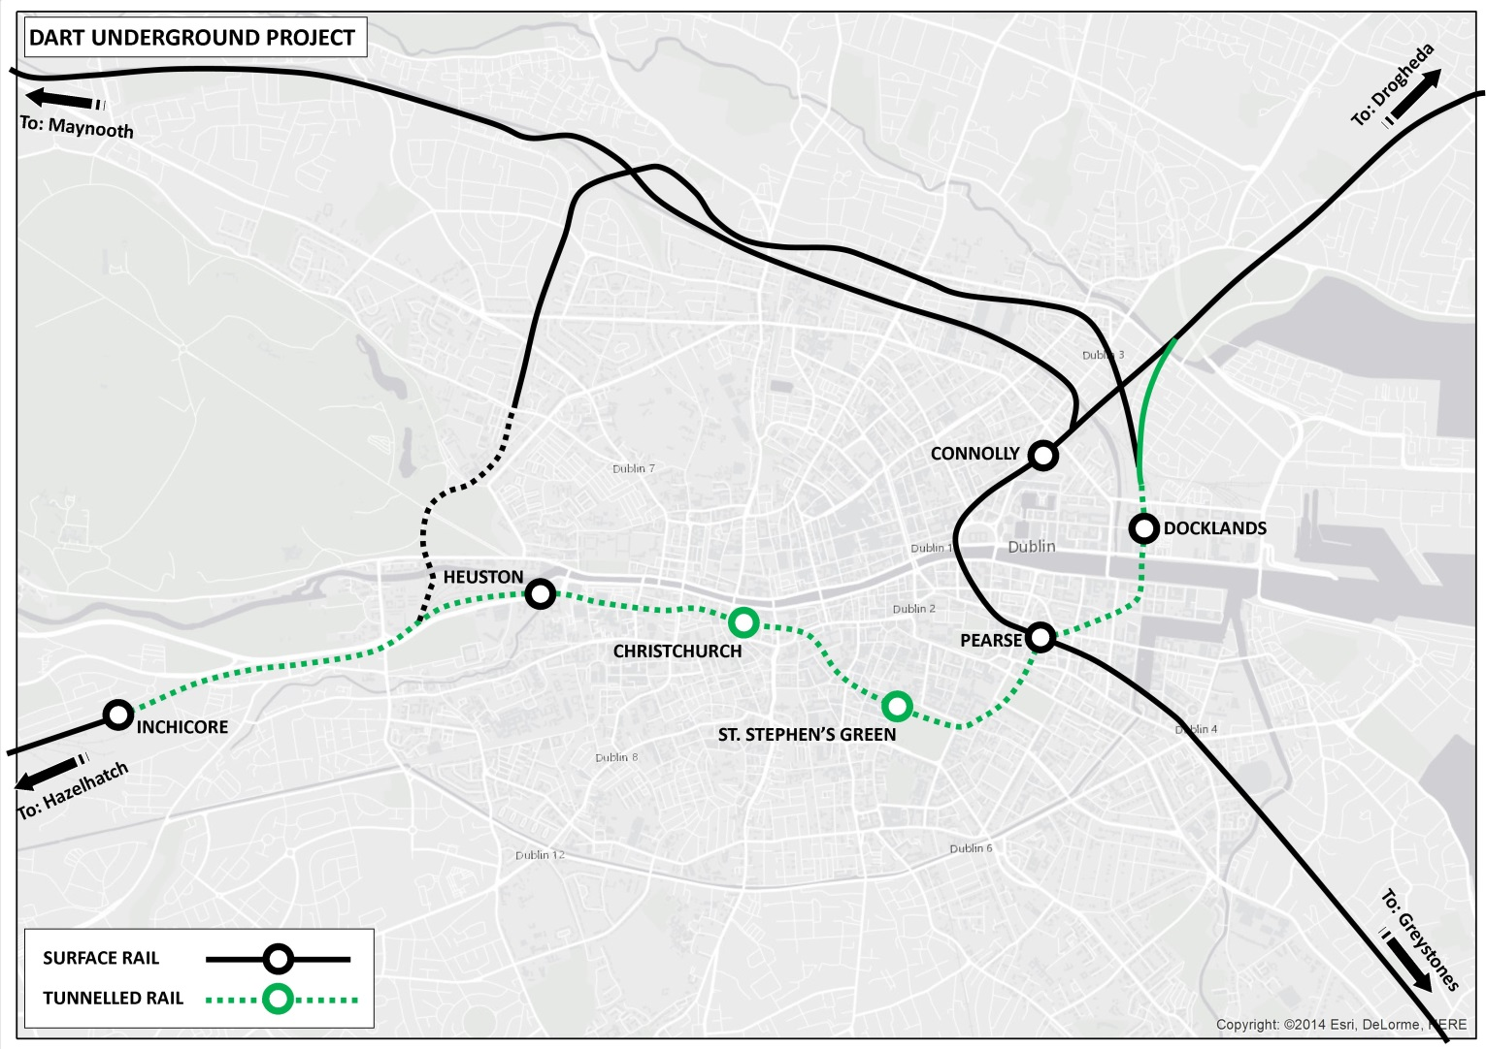
DART Underground Project
Extent of the DART Underground Project in Green above

Slide 5
Business Case Review
Revised business case completed - key element is the cost benefit analysis (CBA)
DART Expansion Programme
  €4,007 million Capital Cost
DART Underground Project
  €2,994 million Capital Cost
Strong economic case for the DART Expansion Programme
  1.4 Benefit to Cost Ratio
The case for the DART Underground Project without the other elements of the DART Expansion Programme is not as strong
  The benefits generated would be less than the overall cost
  0.8:1 Benefit to Cost Ratio

Slide 6
Conclusion
It is considered that a lower cost solution for the tunnel is possible – e.g. tunnel to Heuston not Inchicore
Recognising that the scheme could be changed to a lower cost scheme, and that the business case does not justify the project under the current Railway Order, it is intended that the CPO is not activated and that a new Railway Order is sought for a lower cost revised scheme
Possible alternatives that will be considered for a revised tunnel follow. There will be other possible options that will be considered through more detailed analysis
The DART Expansion Programme remains a key project in the delivery of an integrated rail transport network for the Dublin region
The Minister for Transport, Tourism & Sport has indicated that the forthcoming Capital Investment Plan will make provision for advancing this expansion programme

Slide 7
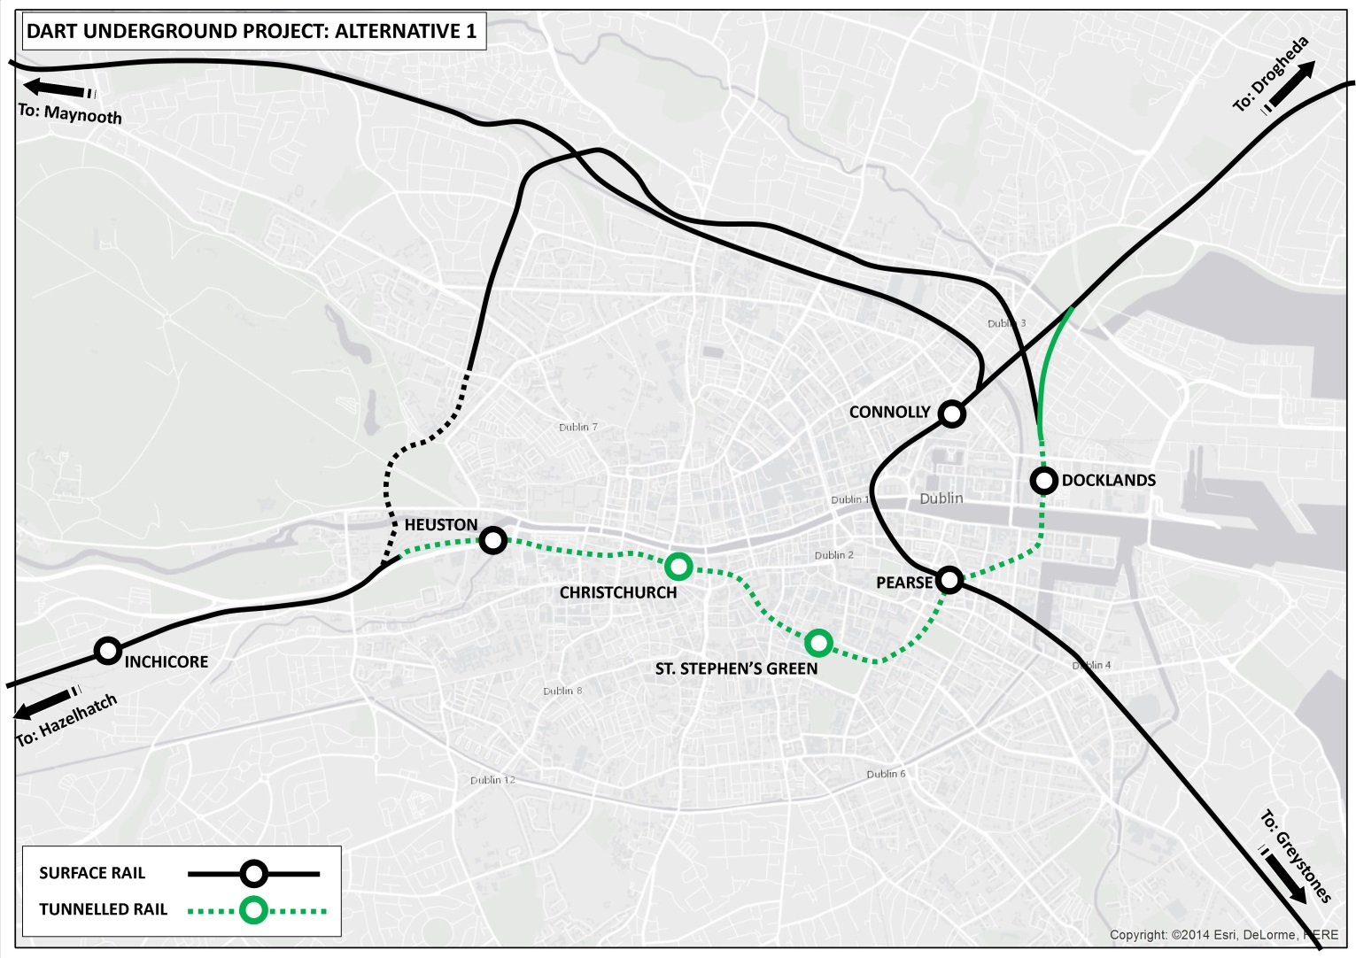
Alternative 1- Tunnel to Heuston not Inchicore

Slide 8
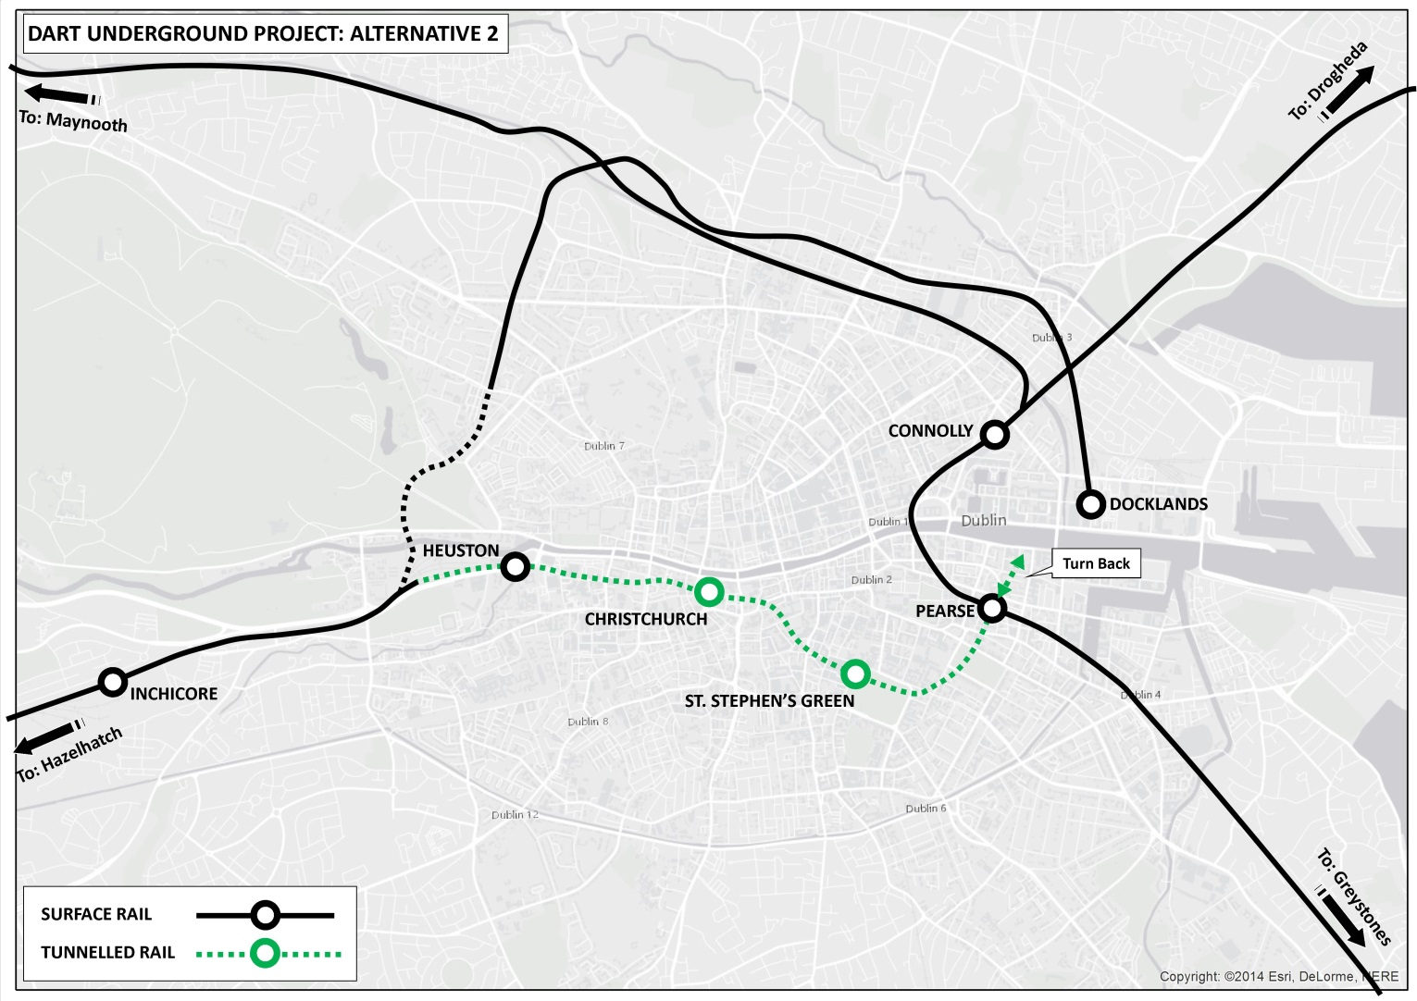
Alternative 2 – Tunnel only between Heuston and Pearse

Slide 9

Alternative 3 – Shorter Tunnel and Fewer Stations

